Slide 1
Religions of India
Ch. 25 in Geography Textbook

Slide 2
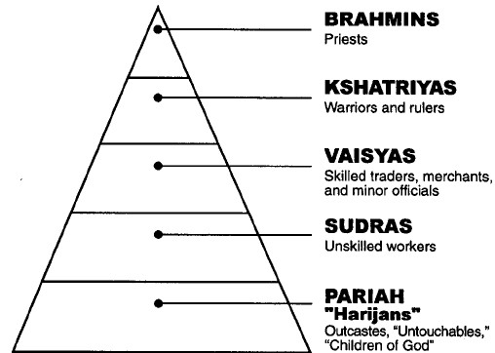
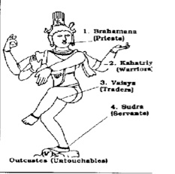
Hinduism: Key Beliefs
Vedas (Holy Writing) and Varnas (Caste System)

Slide 3
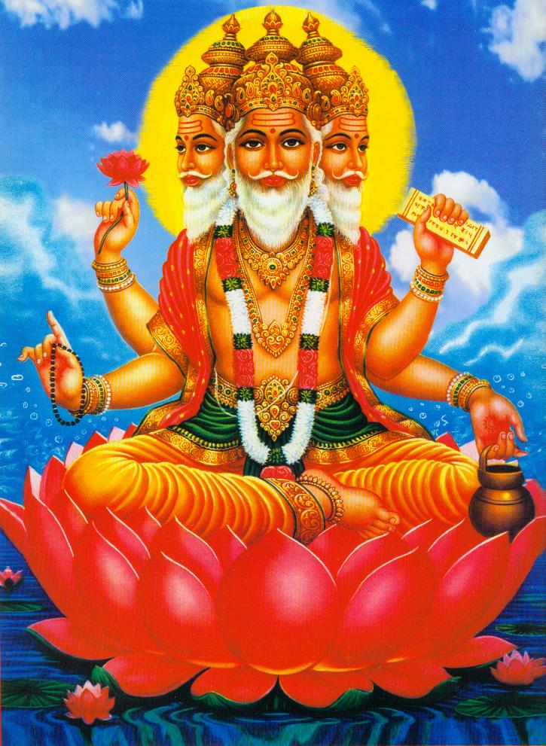
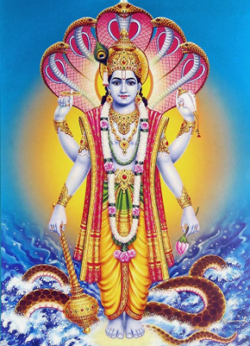
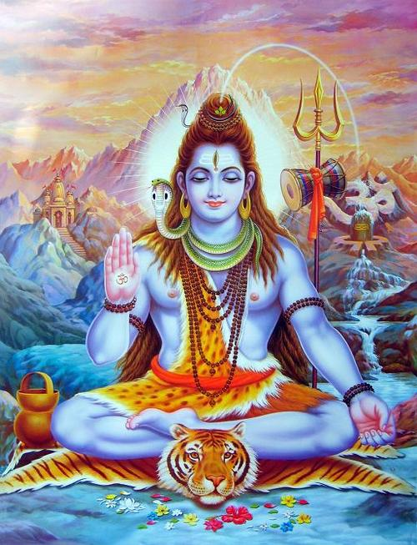
Hinduism = Polytheist (>3 million gods) But they have 3 main ones)
Brahma: The Creator
Vishnu: The Preserver
Shiva: The Destroyer

Slide 4
Hinduism: Key Beliefs (continued)

Slide 5
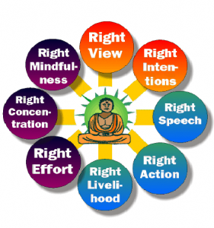
Buddhism: Key Beliefs Founder: Siddhartha Gautama (Buddha)
GOAL: ACHIEVE NIRVANA (state of perfect peace)

Slide 6
Quick Quiz Geo: Ch. 25a
Hindus believe everyone is born into a 1. _______ system and needs to fulfill their 2. ________ in that role. 3. They believe that _______, or the good works/actions someone does, adds up, and that if they did enough good works, then they can go up a level when they are reincarnated. Their goal is to be freed from the reincarnation cycle or __________.

Slide 7
Quick Quiz: Ch. 25b
Buddhism started with a prince named ________ ___________. He came up with the idea that all __________ is caused by ___________. The way to get rid of desire is to follow the _________ _________ _________.
These religions influence India and the surrounding countries. Also ___________ winds that bring moist or dry air to an area affect people’s daily lives.

